Slide 1
Open Sourcing From Within Your Company, For Your Company
POSSCON, Wednesday, March 28th 2012
by Bob Williams
Notes:
Thank you for having me
I’m really glad and honored to be here
What a great event this is…how about a quick round of applause once again for posscon ☺

Slide 2
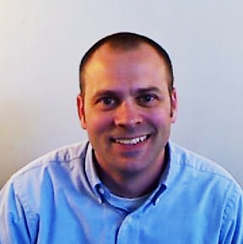
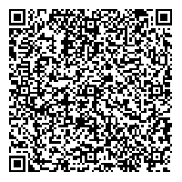
About Me
Bob Williams
CTO
bob.williams@sparcedge.com
Twitter
@_bobwilliams
Come see Innovation, Culture
and Open Source in Action
tours@sparcedge.com - tours held daily.
www.sparcedge.com
Notes:
So real quick, who am I?
My name is Bob Williams
I am the CTO for SPARC
I am responsible for leadership, technology vision and direction
I am very active on Twitter. You can find me @_bobwilliams
And I am very passionate about open communication, innovation through collaboration and free exchange of ideas
Which is great because

Slide 3
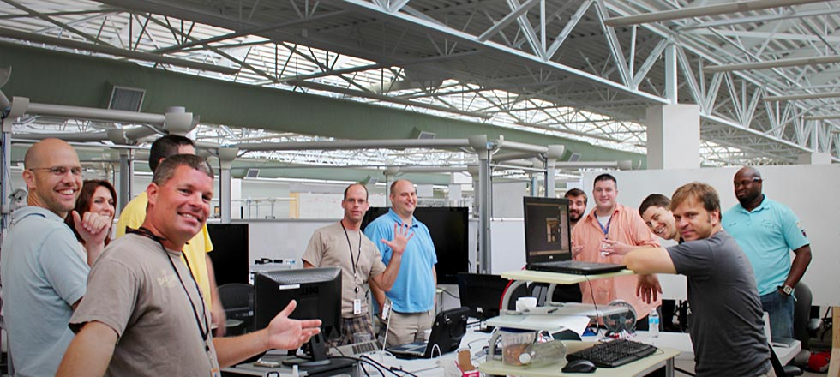
Welcome to SPARC!
Software Development
2011 Best Place to Work in SC
150+ employees / 498% Growth in 2011
Notes:
The company I work for fully embraces my passions
At SPARC we believe we engage people through better information
We Innovate, we freely exchange ideas and we contribute to each others success
We have a really good work environment
Decent size shop and we’ve grown a lot
And oh yea…we write software ☺
Whether it be for Enterprise, Cloud, Web, Mobile, Cyber, Analytics, Culture, Engagement, Green Energy

Slide 4
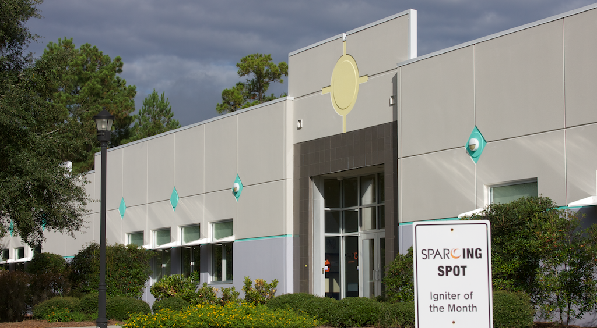
Walk With Me
Notes:
So before we jump into the presentation I want you
To put all you project work and tasks aside…trust me…it’ll be there when you get back ☺
Put all those frustrations, stresses, pressures and deadlines aside.
Take a deep breath, hold it a sec and let it out slowly
Close your eyes, everybody…no peaking...and take a walk with me as I come to the entrance of SPARC (our company) on a Monday morning.
It’s a sunny day outside…birds are singing and there’s a slight breeze so it’s not too hot…no mosquitos, we’ll just leave those out of this…it’s just right ☺
We walk inside our company building and we’re immediately greeted with a smile and a good morning
As we come in around the front desk
We hear some jovial laughter
We see engaged team members collaborating and solving problems together…using whiteboards as they hash out a solution
We see guests on a tour in the building and they are at one of the many project tables asking the team to tell them about the project they are working on
We see our partners working beside us and as a result
We see and our business growing and processes maturing.
We walk into the café and smell the morning’s coffee and overhear two engineers discussing the mobile apps they created over the weekend
We hear the excitement in their voices as they discuss the latest technologies they used and what great feedback their supervisor gave them on it
We see over in the corner our CEO having an open forum meeting with team members of varying roles, titles and responsibilities as well as a potential candidate
as they as the CEO very direct questions and receive very candid answers
We even see our CEO solicit advice and ask them what they think…what would they change…how would they make the company a better place…what should it be focusing on
Ok…open your eyes.
Sounds good right? Who wouldn’t want to work a company like this?
My promise to you is that you is that this doesn’t have to be a story where we close our eyes
That you too can have a more engaged and excited workforce with greater innovation
You too can have people from outside as well as inside hone your business and make it run better, faster and stronger
You can have who used to be thought of as your competition become your collaborators
And you can get all this for free
How do you do this?

Slide 5
Open Source Your Entire Organization
Open Source Everything!
Notes:
The secret is to open source everything
Yep, that’s right, open source your entire company.
I don’t mean just use open source software,
I mean use the open source model in your HR department, in your finance department, open source your recruiting processes
I mean give away those things you would typically consider your intellectual property and company secrets
So, who believes they could open source their entire company?
Who believes their entire company would expose or give transparency into what you would typically consider intellectual property and company secrets.
Anyone? Show of hands? ☺
Yes, it’s a serious change in perspective and one that at first seems to come with a tremendous amount of risk.
However, that’s exactly what we are doing at SPARC. We are open sourcing our company more and more everyday.
Now, I know open sourcing your entire company that might seem to be a bit too much at the moment
However if you do, the promises I just mentioned
A more an engaged and excited workforce with greater innovation
People from outside as well as inside hone your business and make it run better, faster and stronger
People who used to be thought of as your competition are now your collaborators
And all this for free
Can be realized
So let me show you what you can do to get there. The steps to take.

Slide 6




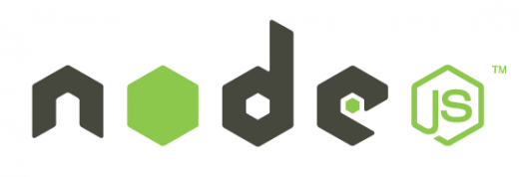
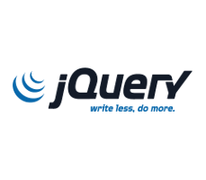

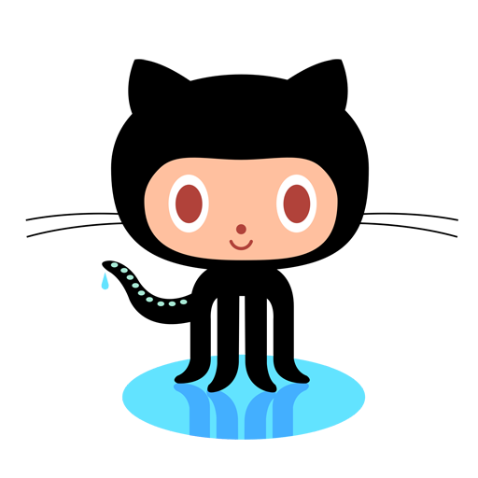


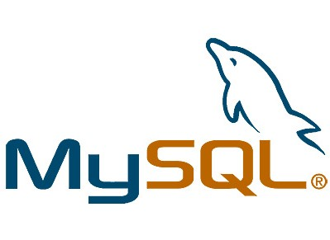


Step One – Use
Find open source software that you can use in your projects.
Get used to it and the open source model.
Take that first step to using it!
Notes:
So, step one is to support open source
Allow it, get used it, learn about it
Find projects you have today that can leverage open source software
Maybe that’s a lower risk project to use as your comfort builds
Maybe that’s an internal or R&D effort
But bring open source software inside your walls so you can understand the model and take that first step.

Slide 7
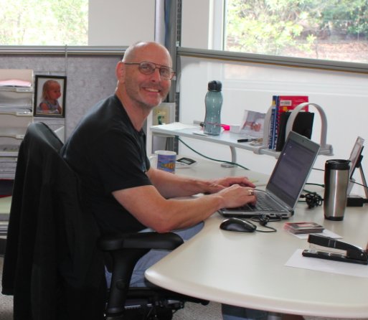
Step Two – Contribute
Give back to the community and uphold your end of the open source agreement.
Learn the “share/make it better model” of open source.
Take that next step!
Notes:
Now that you are using open source the next step is to contribute back to the projects you are using
This may seem like a trivial step or one you can overlook but let me stress that it is very important
Contribution is an often overlooked piece of the open source agreement
Community is the other piece of this. Aren’t we by nature more likely to help others who help us?
If someone does something for you and asks for a favor, aren’t you going to be more likely to help that person out?
We have developers that have contributed to the two topmost projects in GitHub.
When they have a question they can jump on irc or chat and get an answer in seconds…they’ve built a community around the contribution
How many times has an engineer downloaded jQuery or one of the apache open source projects and made a change to the source?
How many times does that change get pushed back into the project?
Rarely is often the case
The contribution step really allows you to learn this symbiotic nature of share and then make better that is one of the promises of open source
Take that next step!

Slide 8
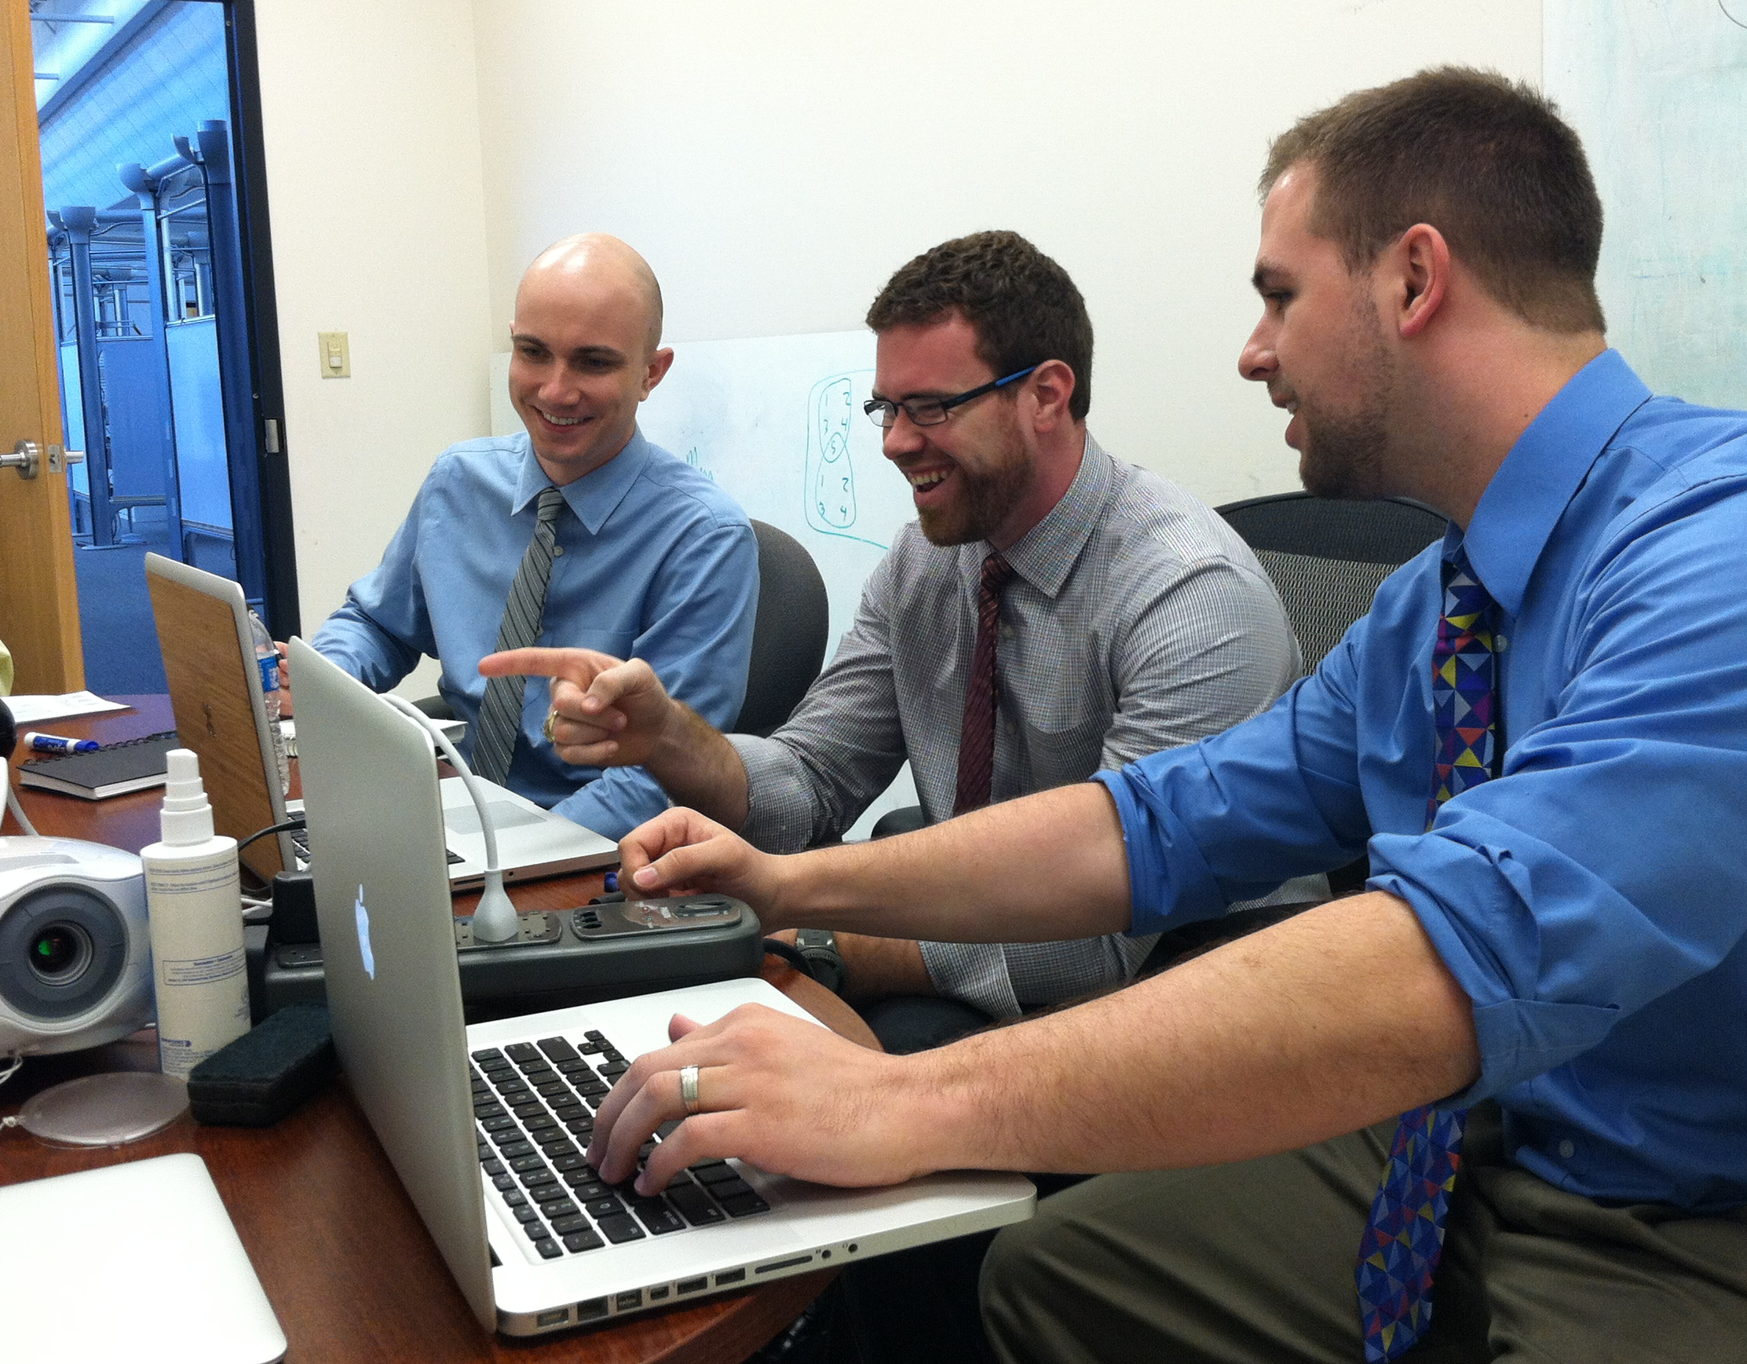
Step Three – In-House
Learn how to open source your own project(s).
Allow them to work together across teams and build better collaboration.
Create excitement and additional energy!
Notes:
So, now you’re using open source and contributing back to it.
The next step you need to take is to create an in-house open source solution.
As with the last step this one might seem trivial or one that you can easily skip but it’s just a critical as any of the steps.
We are looking to open source our company before we take that leap, let’s first understand how it all works
Let’s create an in-house github or bitbucket or similar and get used to as well as learn how to open source something from the ground up
Create the support for your engineers to contribute to each others projects
This step really starts to building excitement and energy within your teams and company as a whole
Collaboration really increases and we see more cohesion across all teams
If you need to, set some boundaries or structure around this
For example, after 5pm is when people can start to contribute
The goal here is to learn how to create your own open source project and you really start to see the benefits

Slide 9
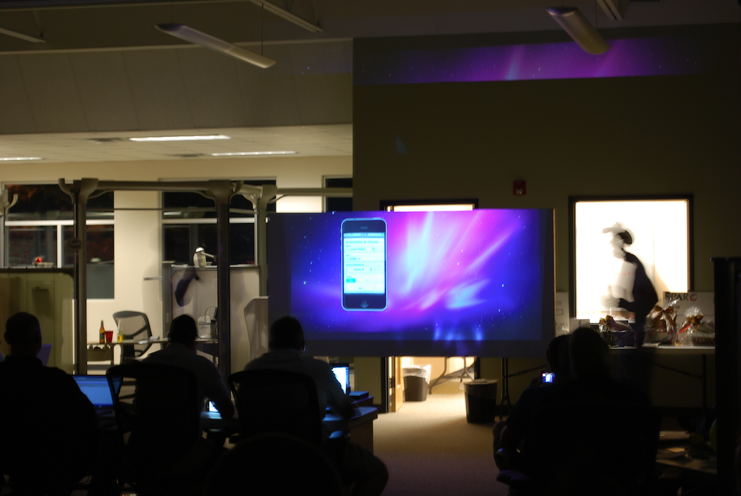
Step Four – Review
Developers like clout and like to be heard.
Let them show-off to their peers, managers and the company as a whole.
Give them bragging rights!
Notes:
Ok…now we’re using open source, we’re contributing back into the community, we have our own in-house projects so we understand the model even deeper
Now we want to review
Developers like clout and bragging rights...give them a way to show-off to their peers, their leaders and management, the executives, their entire company.
Let developers gain acceptance and build trust
This is a step by which you start to hone your open source path and bring into play continual improvements

Slide 10
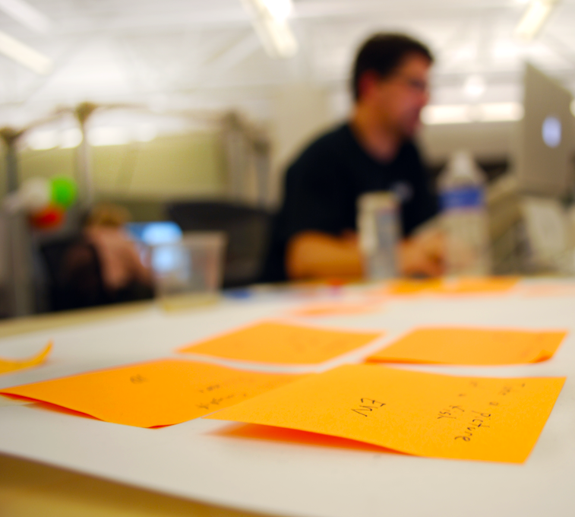
Step Five – Expand
Now that you have embraced open source, don’t stop.
In what other areas of your company could you apply the open source model?
Find ways to capitalize on the advantages of the open source model throughout your entire organization!
Notes:
So, we have a pretty good grasp of the open source model
We’re using it and have learned a great deal there
We’re contributing back to project and understand the community aspect
We’ve brought it in-house and have learned how to open source a software project ourselves
We’ve created this review process where developers get bragging rights and we get to continually make our embracement of open source better
So, now we just have to expand.
What areas of my company can I open source? Is that HR? Is that Recruiting?
You might want to start small here and you go through the process but don’t stop now…expand…
open source your company!
As you think about where to start here are some ideas to get you started
Here are some of the things that SPARC Open Sources

Slide 11
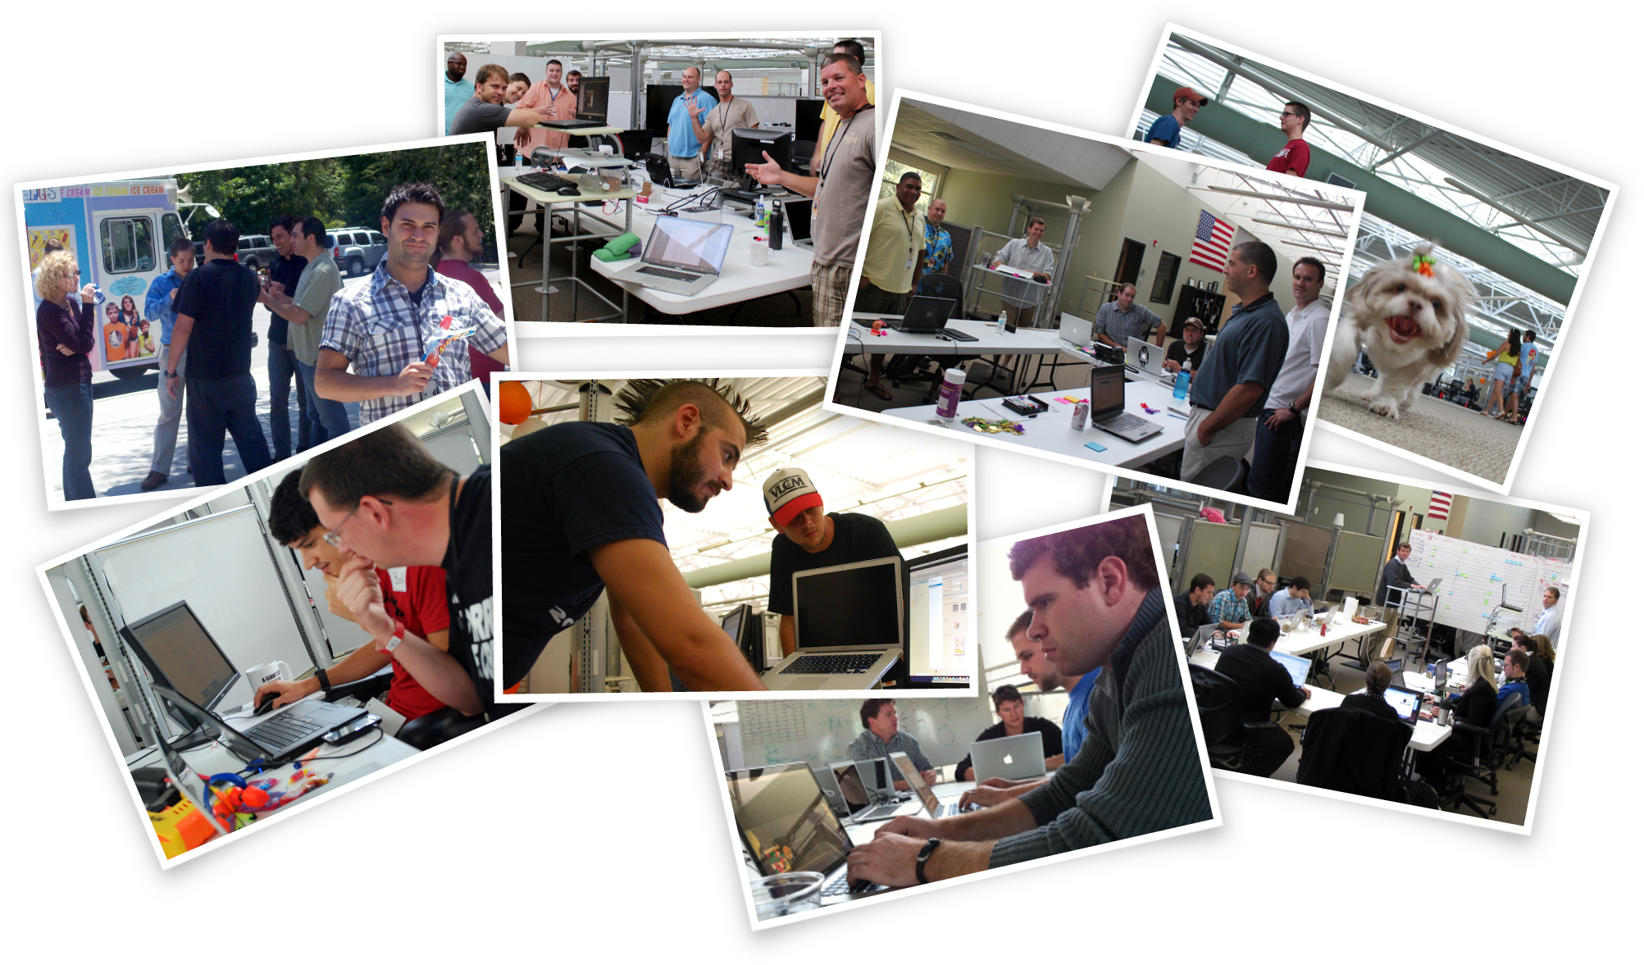
Tours
Notes:
Let’s start with tours.
We have transparency at every level here at SPARC that starts once you walk into the building
Our tours are not scheduled meetings in a conference room
They are open free forum events where you can take anyone aside and ask, “how are things here at SPARC?”
You get access to everyone and all the rooms, all the projects all the insight we can give you
You get to sit with the CEO and ask questions
Stay as long as you want…it’s up to you and when you feel the tour is over and your answers have been answered

Slide 12

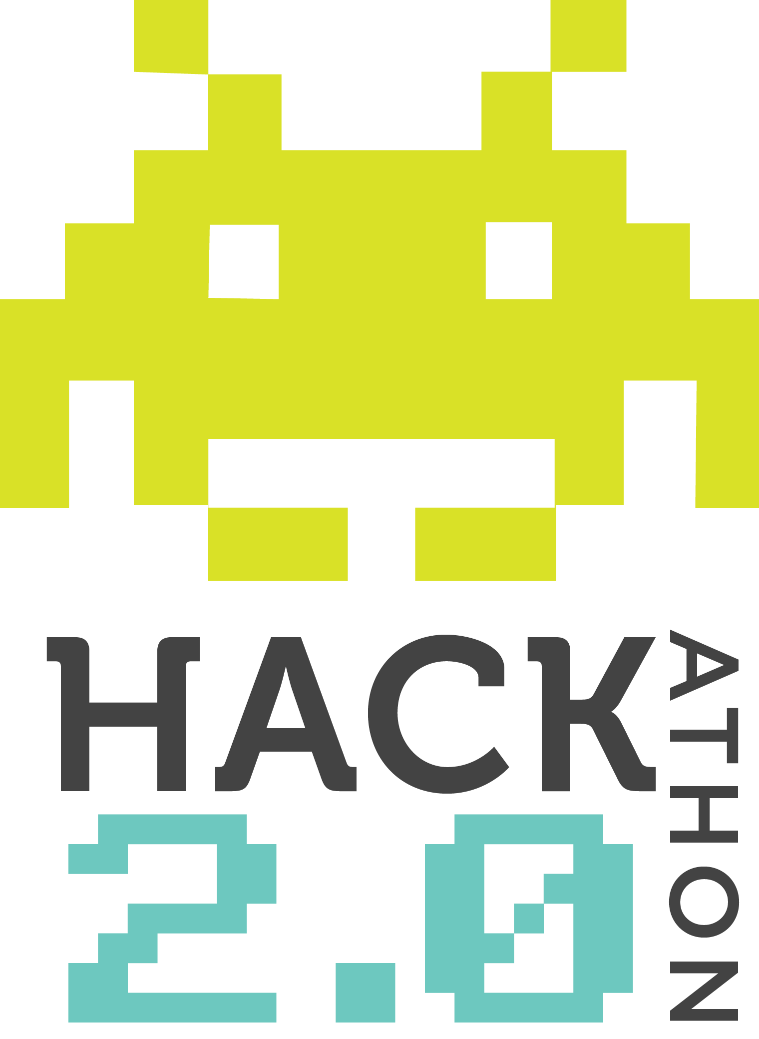
Hackathons
Notes:
How about hackathons.
The hackathons are all day coding contests
Open to public…anyone can attend
Food and beverages are provided
Basically
Engineers from all over form teams of 2 – 5 typically
The public/audience submits ideas for applications they would like to see built
The engineering teams then pick which ideas they would like to work on and the competition begins
At the end of the hackathon winners are selected in several categories
Cash and material prizes are awarded to the winning teams
And rather than SPARC or the teams keeping any of the intellectual property for the applications
They are all open sourced and given back to the community
In fact, the winners from the last hackathon gave all their monetary winnings to charity

Slide 13
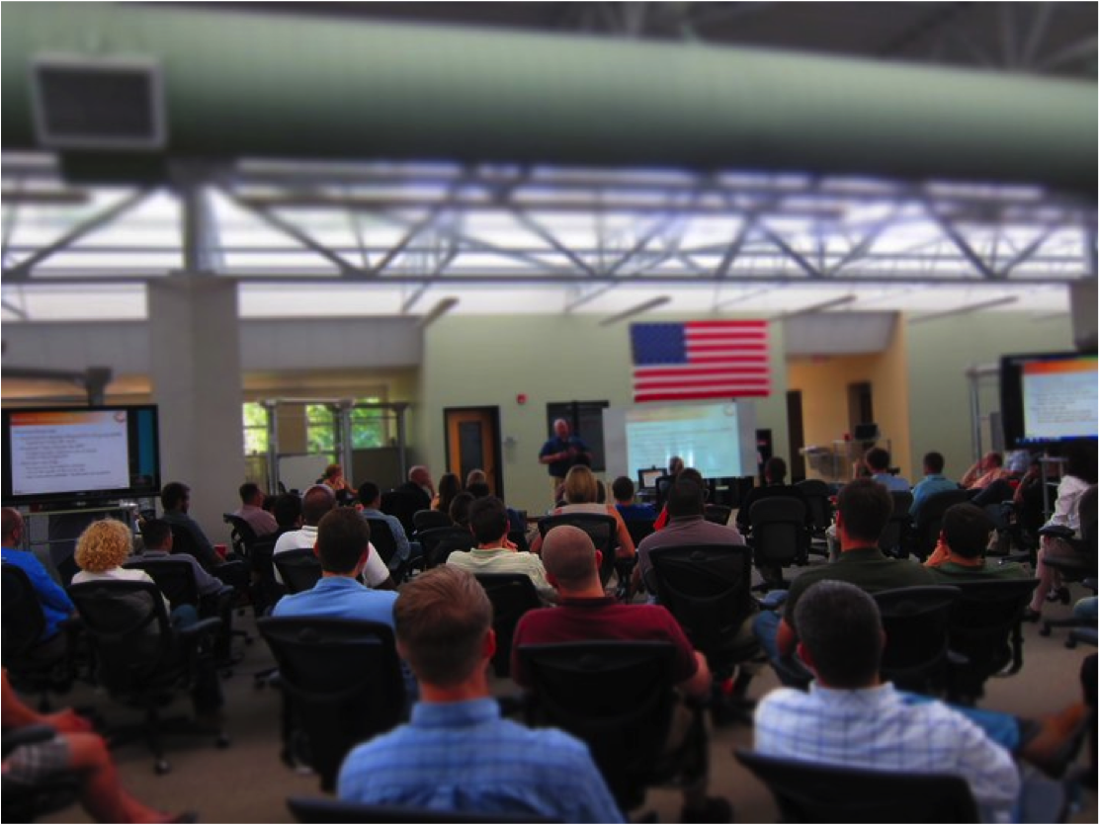
SPARC University
Notes:
SPARC has a saying which goes something like, “if we only train on what we know and build today, then we’ll only be as good as we are today”
So along the lines of continually bettering and growing ourselves we have an investment in what we call SPARC U
A way for not only SPARC employees to learn but for anyone who is interested to learn
We host, sponsor and give a number of courses and classes
From mobile, to java to agile software development to many more
Some of then are via lunch-and-learns
Some via user groups
Some are multi-day long classes; android development for example
And while they are open to all of SPARC they are also open to the public
For many of them our own employees have created the content and courses
We have even hosted GitHub, VMWare and Employee Recognition specialists but these were all open to people from outside our walls as well
Also, along the lines of step 3 in-house we have an internal open source repository that our engineers can use to learn and grow their skillset on differing technologies and platforms.

Slide 14

SPARC Ventures
Notes:
Who has heard of Google 20% time? Atlassian FedEx Day?
In a company wide meeting, we once asked the question, “who here has a good idea that they’d like to work on and take to market?”
Almost everyone raised their hand.
So, working through that we decided to give all those passionate people a chance to work on those ideas and get the support they needed to be successful
Anyone who has tried to start their own business knows it hard…it’s damn hard. In trying to start a software company for example, the code itself is at best only 15-20 percent of the overall effort
So, we decided to open SPARC’s SDLC to help our entrepreneurial employees .
From engineering, to finance, to requirements to you name it. They have access to the full stack.
Now, there are a some boundaries such as a submission and acceptance process for ideas
But employees who are selected as a ventures program get full support from SPARC
They get a sizable monetary amount to help out
They get access to all areas of SPARC’s business for support and guidance
They get mentorship from the leaders and executive team
And not only do they get the support and guidance they need but they also get percentages back in ownership and royalties of sales.
They get to be CEOs if you will for their good idea.

Slide 15
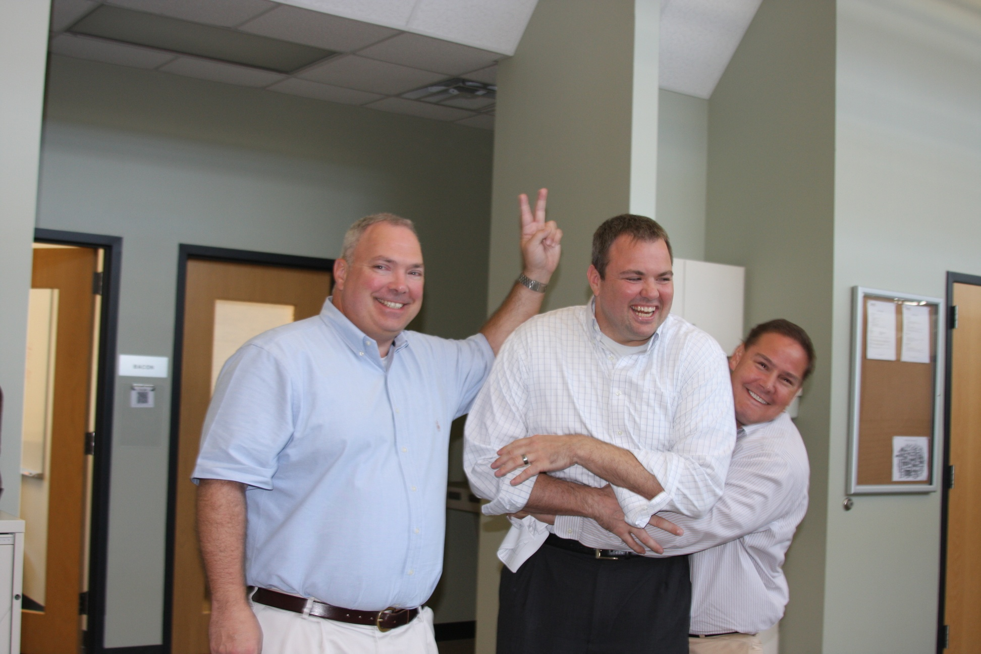
Human Resources
Notes:
Human Resources is a big one we open source
Almost all of us all familiar with the check-in process that we have…well we’ve actually given that away to other companies
We’ve shared it, we’ve solicited feedback and we’ve made it better
Same with our Annual Review Process
And how about the goal setting process…rather than senior support pushing goals down onto everyone, we have the goals being pushed up.
You are in control and the ones defining and contributing

Slide 16
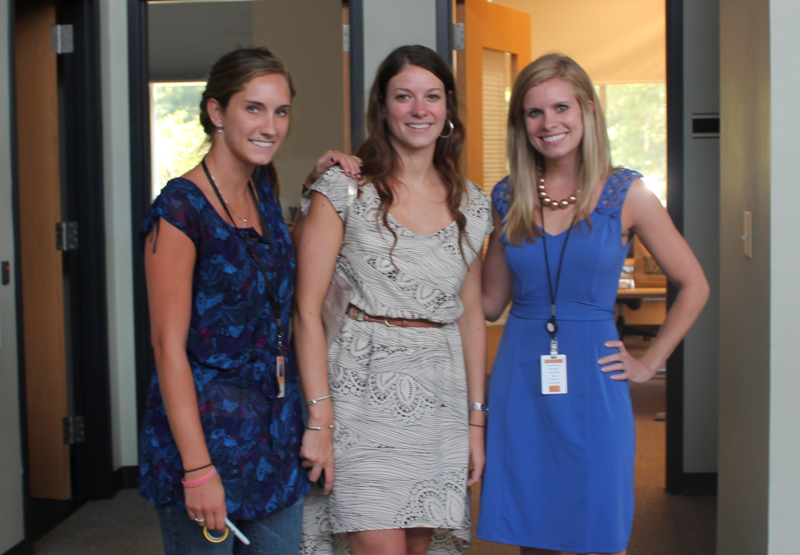
Recruiting
Notes:
We open source Recruiting.
Our interview process is extremely open.
We believe in hiring on culture, aptitude and resume in that order.
Anyone can sit in on any interview
We have a single veto policy where anyone can say no for any candidate…doesn’t matter what position that person is applying for\
Everyone has access to all the comments for a given candidate as well as any of the interview tests we give
And we strongly advocate a shadow day…this is a day where the candidate comes into our building and sits for the day along side the teams
The candidate gets to see if this is really the way it…there’s no bait and switch
We also help spouses and family find jobs…we’ll work with them on their resumes, job searches, you name it
And if for some reason there isn’t a fit between us and a candidate for whatever reason we will work with them just the same and help with resume and job searches

Slide 17
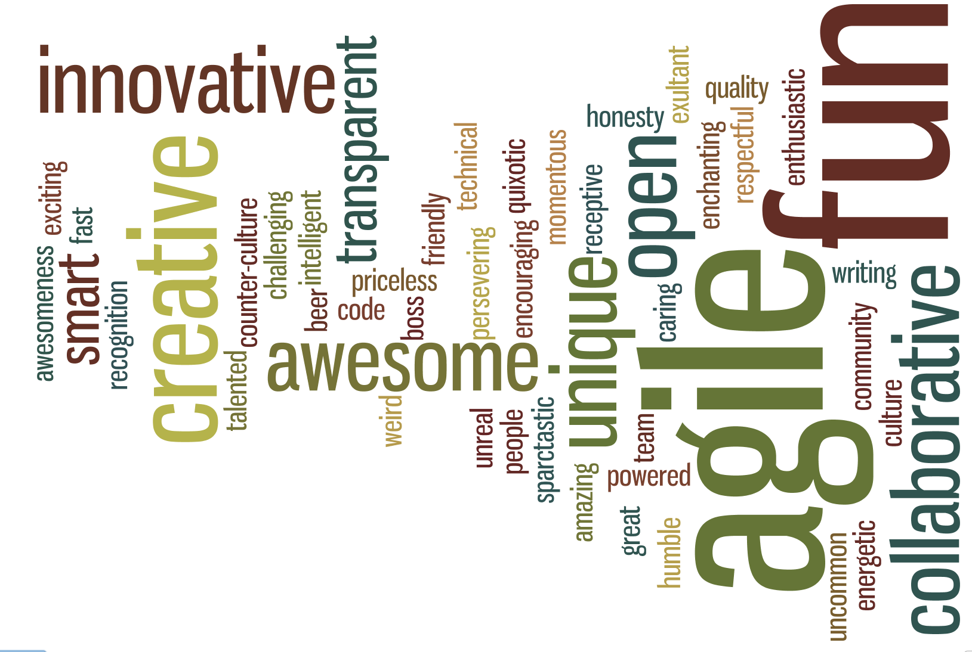

Culture
Notes:
Transparency in everything we do
An open culture
A culture where whether your are a 1st day intern or the 1st employee hired you feel and know that you do not need permission to contribute.
To contribute to any area of the business
Tours
Project Updates – used to be an executive only meeting
now open to everyone every week
can ask questions
SPARC Spontaneous – similar to project updates but longer and spontaneous
monthly meeting only to everyone
ask any question
Sparc showcase - in depth project disclosure
open to everyone
see demo
roadmap
backlog
sales update
Clients in the building and people working here
get people in our building
desks for people that do not work here and do not have a direct need to be here
open source our environment
Table Time
tearing down the walls we create with desks and cubes
solving problems together
partners and teams from different companies working together
Culture Committee in the larger Charleston area

Slide 18
Your Challenge!
Why don’t we
Open Source
Our Entire Company?
Notes:
So, I posed a bold statement the beginning of this presentation.
Open Source Everything!
I gave you some pretty bold promise too around
A more engaged and excited workforce with great innovation
Of honing and maturing your business and process
Of having your competition become your collaborators
You I even have the steps to get you there.
You’ve seen what SPARC is doing so you have some ideas on what others are doing
So, my challenge to you as you leave today
Would be to ask yourself why don't we open source our company?
Why not take advantage of this model and as a result
have a more engaged and excited workforce
have people from outside as well as inside hone your business and make it run better, faster and stronger
Create stronger innovation, excitement and engery
And you can get all this for free

Slide 19
Oh, and by the way…
This Entire Presentation Has Been Open Sourced!
blog.sparcedge.com/open-source-your-company
Notes:
Oh and btw…as I have said SPARC, is embraces the open source model
and in that spirit we have open sourced this entire presentation which you can find at the above link
It’s free to you to take and use as needed and improve as you want
I only ask that if you do please drop me a line and let me know…I’d love to hear from you

Slide 20
Thank You!
Notes:
Ok, I’ve taken up enough of your time and want to thank you for being a part of this
If you have questions I’ll be around, please come find me and we can chat
I’d also like to reiterate that if you are skeptical or not sure about all this
Or you just want to see it all in action please do stop by and let us give you a tour
I think you’d enjoy it and I know that we would love to have you stop by
Thank you!

